Slide 1

LIBRARY MANAGEMENT SYSTEM
RAMAN KUMAR
34
MCA 1 EVENING

Slide 2
ACKNOWLEDGEMENT
The satisfaction that accompanies that the successful completion of any task would be incomplete without the mention of people whose ceaseless cooperation made it possible, whose constant guidance and encouragement crown all the efforts with success. I am grateful to our project guide Mrs. Syamala Ma’am for the guidance , inspiration and constructive suggestions that helpful in the preparation of this project. I also thankful to my friends who have helped me in successful completion of the project.

Slide 3
INTRODUCTION
- Library Management System is a window application.
- This project Library Management System includes Login Page, Add Book, List books by title View Books, Search Books, Delete Books and Count Total Books Present In Library.
- It uses files to store book record.
- It is useful for any kind of library .
- Only the Librarian can access this software.
- Information is saved permanently.

Slide 4
Features of this project
LOGIN
DISPLAY BOOKS
LIST BY TIITLE
SEARCH BOOK
ADD BOOKS
DELETE BOOK
NUMBER OF BOOKS

Slide 5
Features OF C USED
FUNCTIONS
STRINGS
FILE
HANDLING
C
CONTROL
STATEMENTS
By Dennis Ritchie
STRUCTURES
LOOPS
ARRAYS

Slide 6
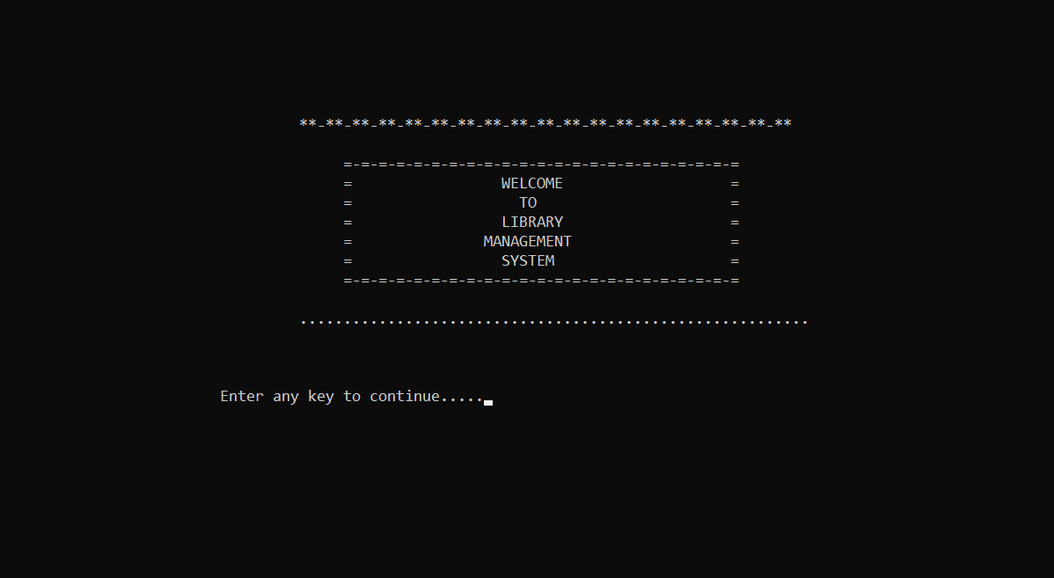
WELCOME SCREEN

Slide 7
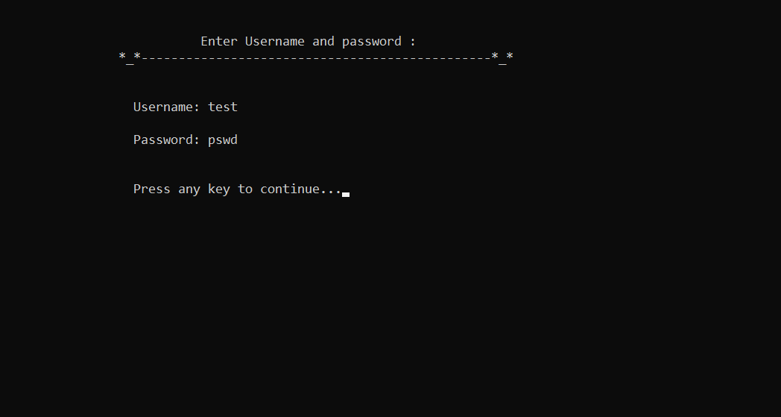
LOGIN PAGE

Slide 8
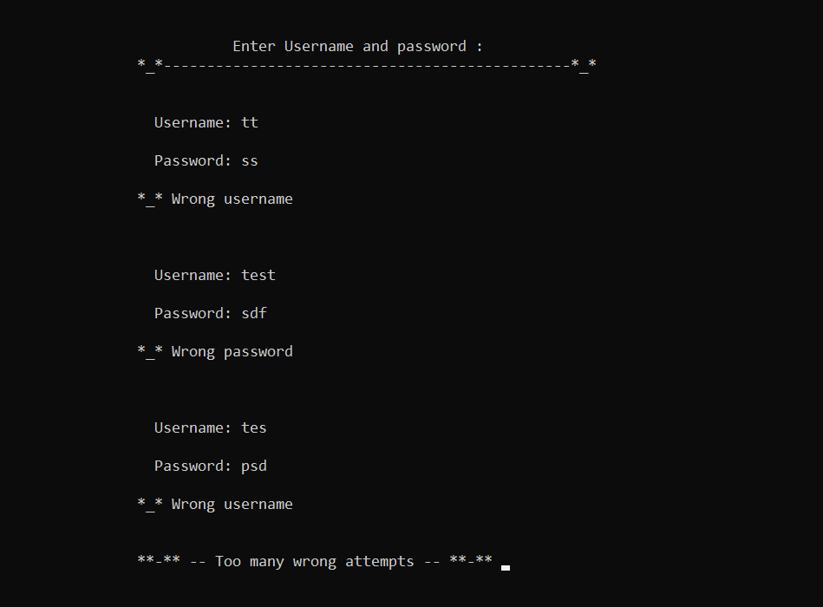
Too many wrong user Id or password

Slide 9
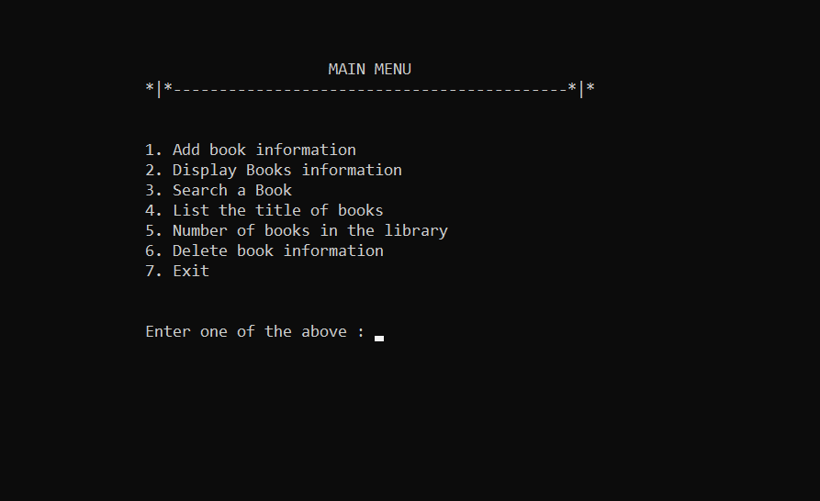
Main menu

Slide 10
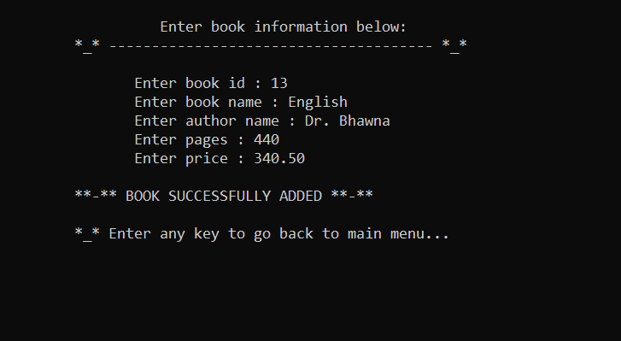
Add book

Slide 11
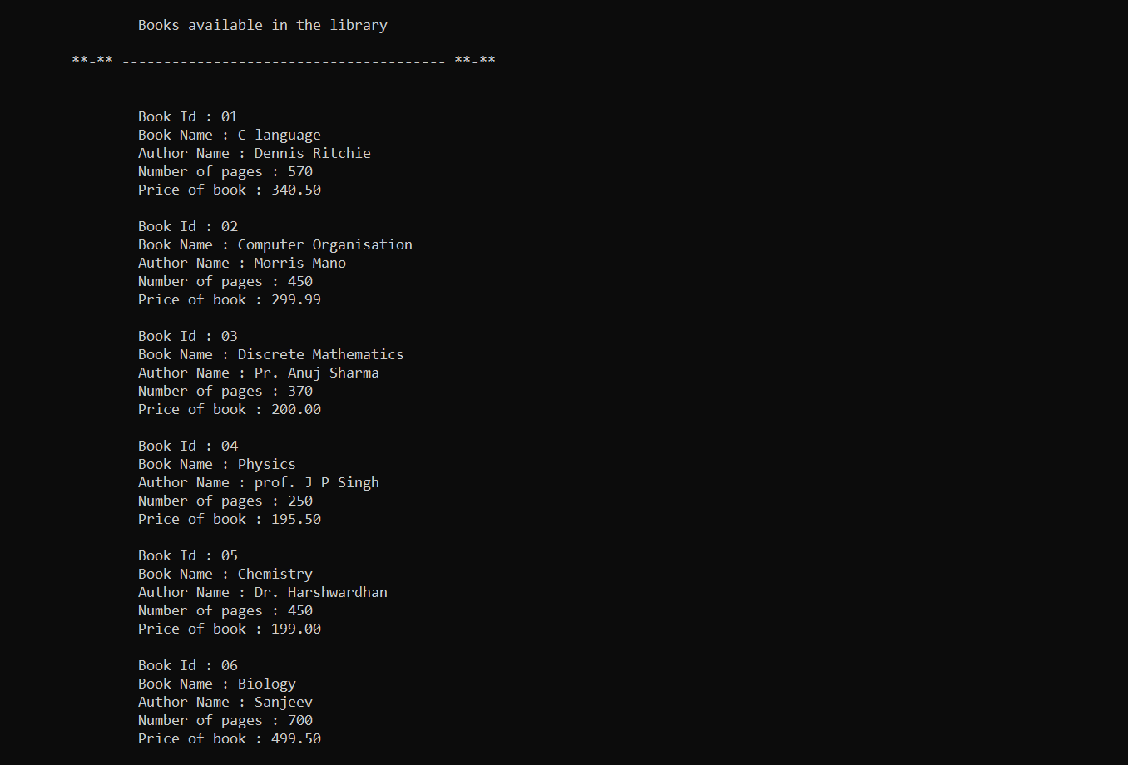
Display books

Slide 12
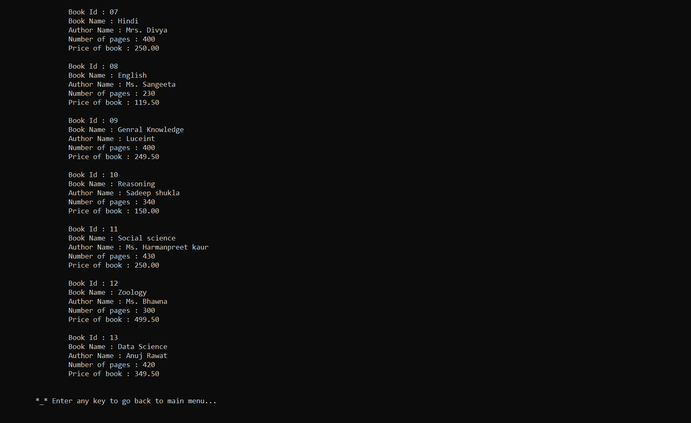

Slide 13
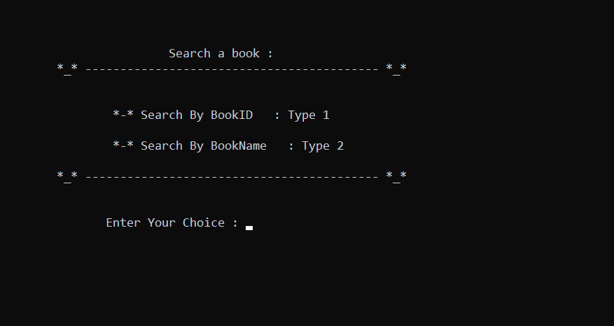
Search a book

Slide 14
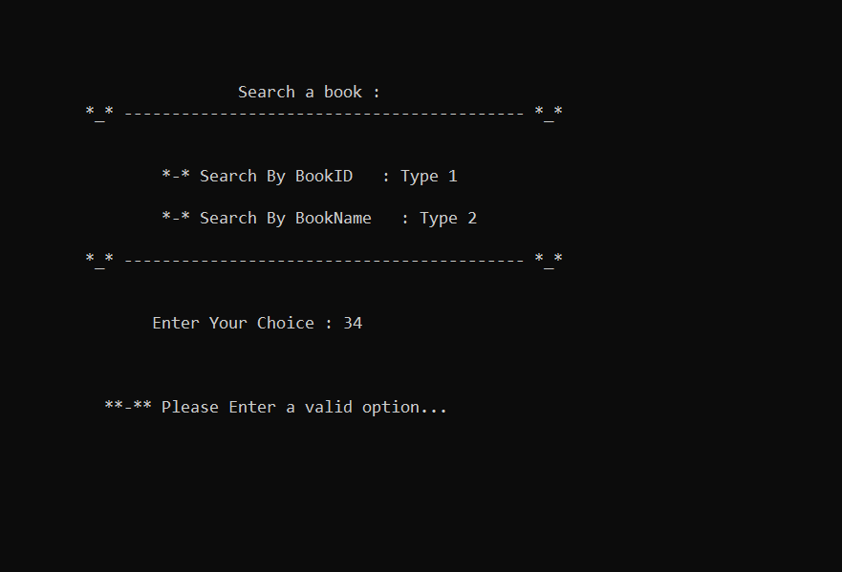
If wrong option is entered

Slide 15
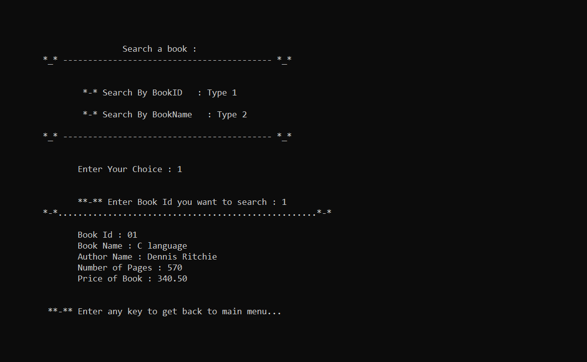
a) By book Id

Slide 16
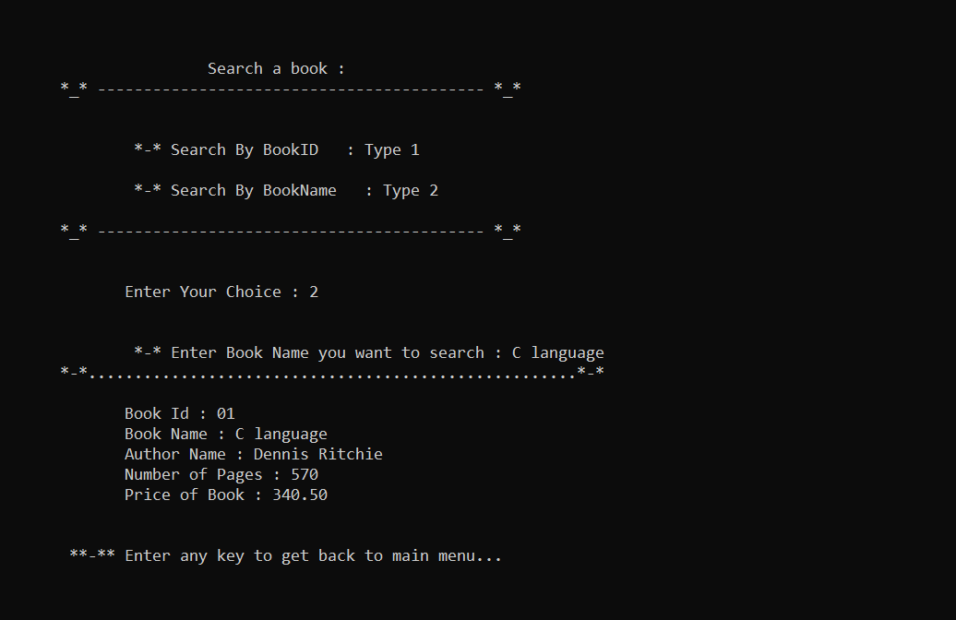
B) By book name

Slide 17
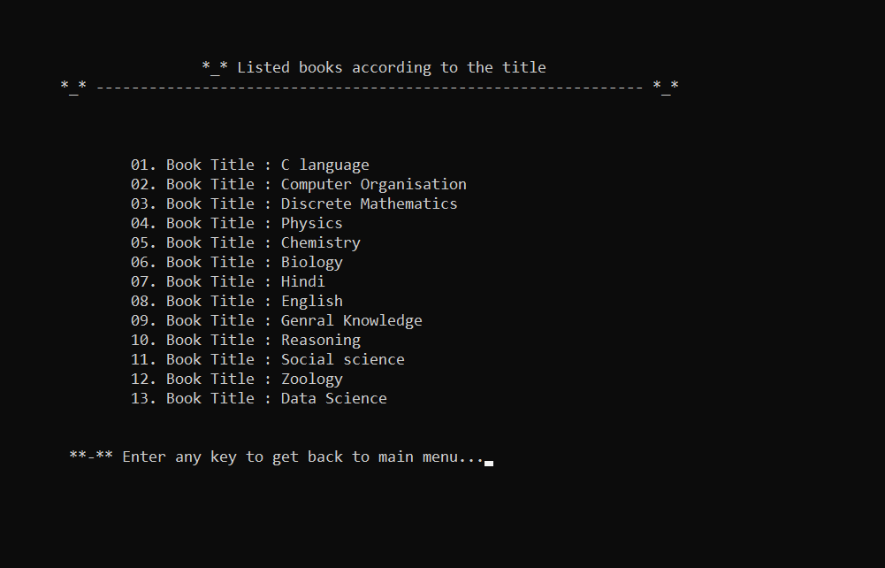
List books with title

Slide 18
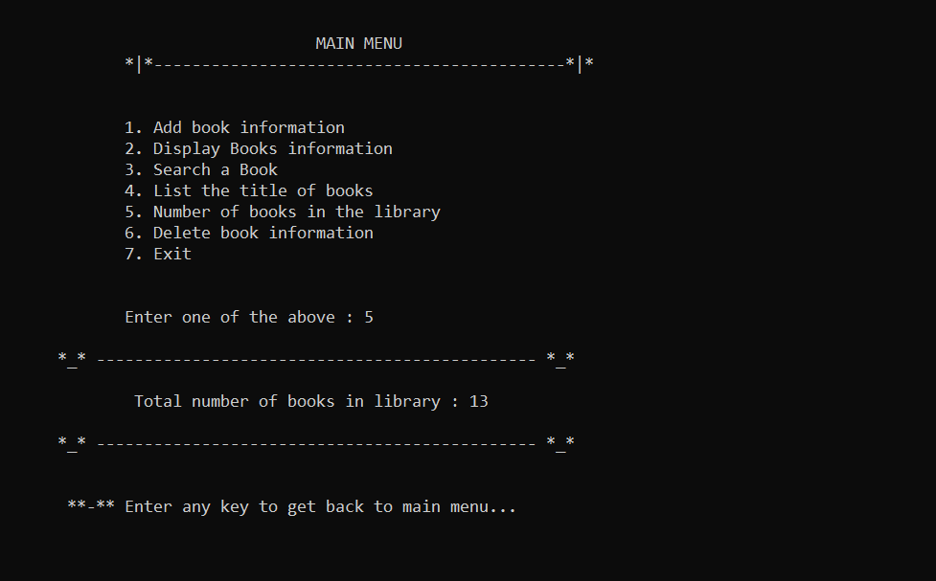
Total number of books

Slide 19
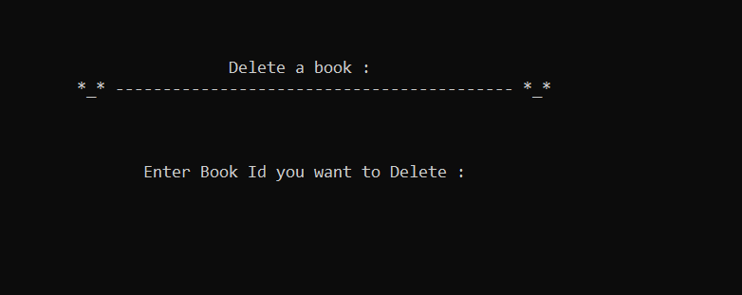
Delete a book

Slide 20
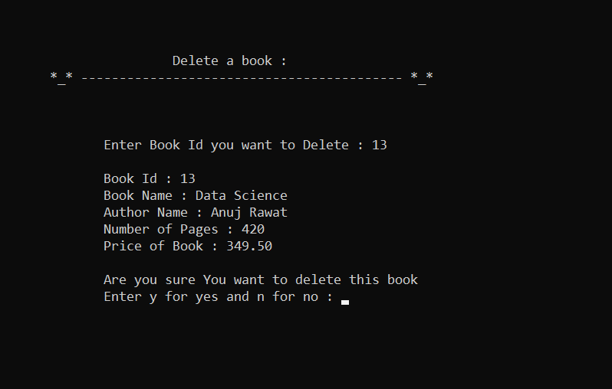
After you enter book id It will show book details and ask for delete or not

Slide 21
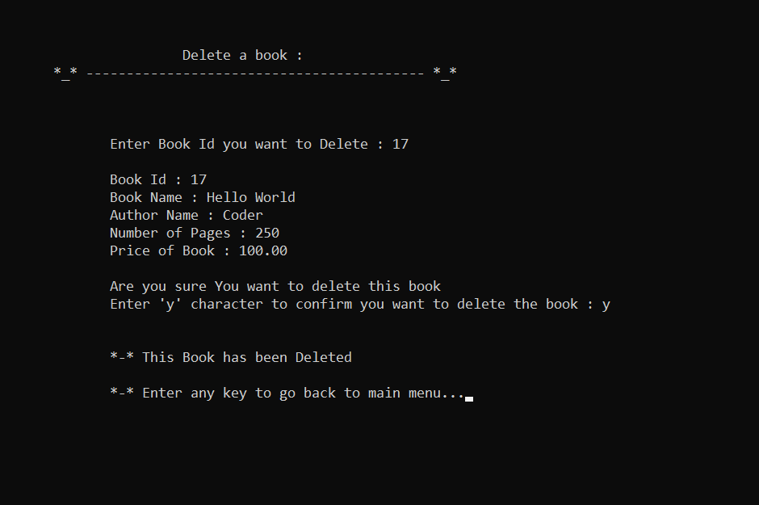
Book will only delete if y char is entered otherwise it will not delete

Slide 22
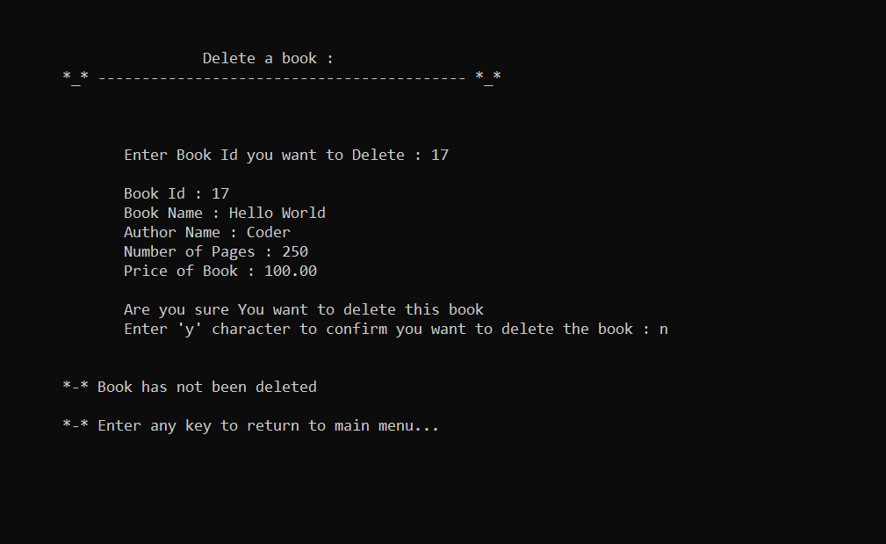
If wrong id or key is pressed

Slide 23
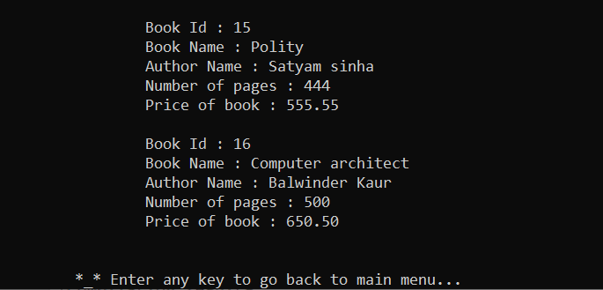
If book id matched and conformation is yes for delete it will be deleted.

Slide 24

End screen

Slide 25

Thank you

